Slide 1
HOTEL BOOKINGS ANALYSIS
Submitted By : Fasna
Date:31/07/2025

Slide 2
Dataset overview
The dataset contain hotel booking records from 2013 to 2017.
Includes over 30,000 entries from both city and resort hotels.
Key variables:
Booking and arrival dates.
Lead time and number of nights.
Average daily rate(ADR) and revenue.
Customer type and distribution channel.
Cancellation status and revenue loss.
Enables comprehensive analysis of booking behaviour, revenue trends, and cancellation patterns.

Slide 3
Objectives
Identify key factors leading to booking cancellation to help reduce cancellation rates.
Analyze revenue pattern across customer segments to discover high-value profiles.
Optimize pricing strategies by examining the relationship between Lead time, Seasonal demand and Average daily rate.
Evaluate the effectiveness of distribution channels to identify the most profitable booking sources.

Slide 4
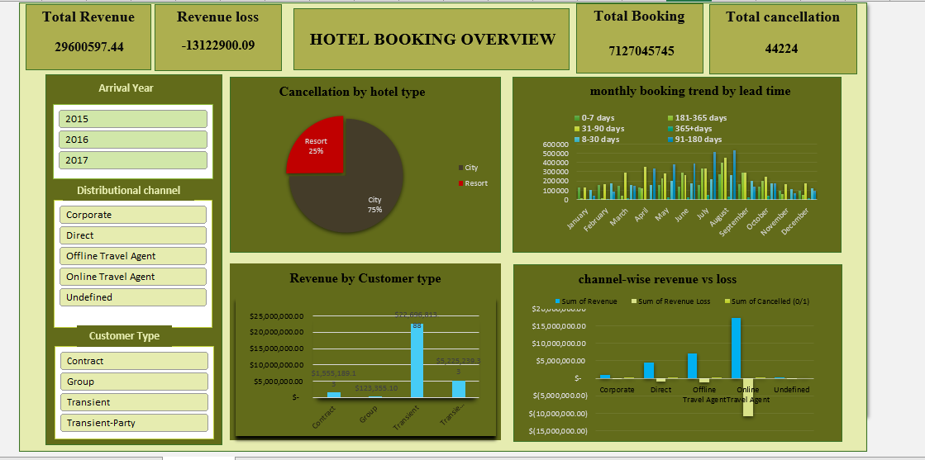

Slide 5
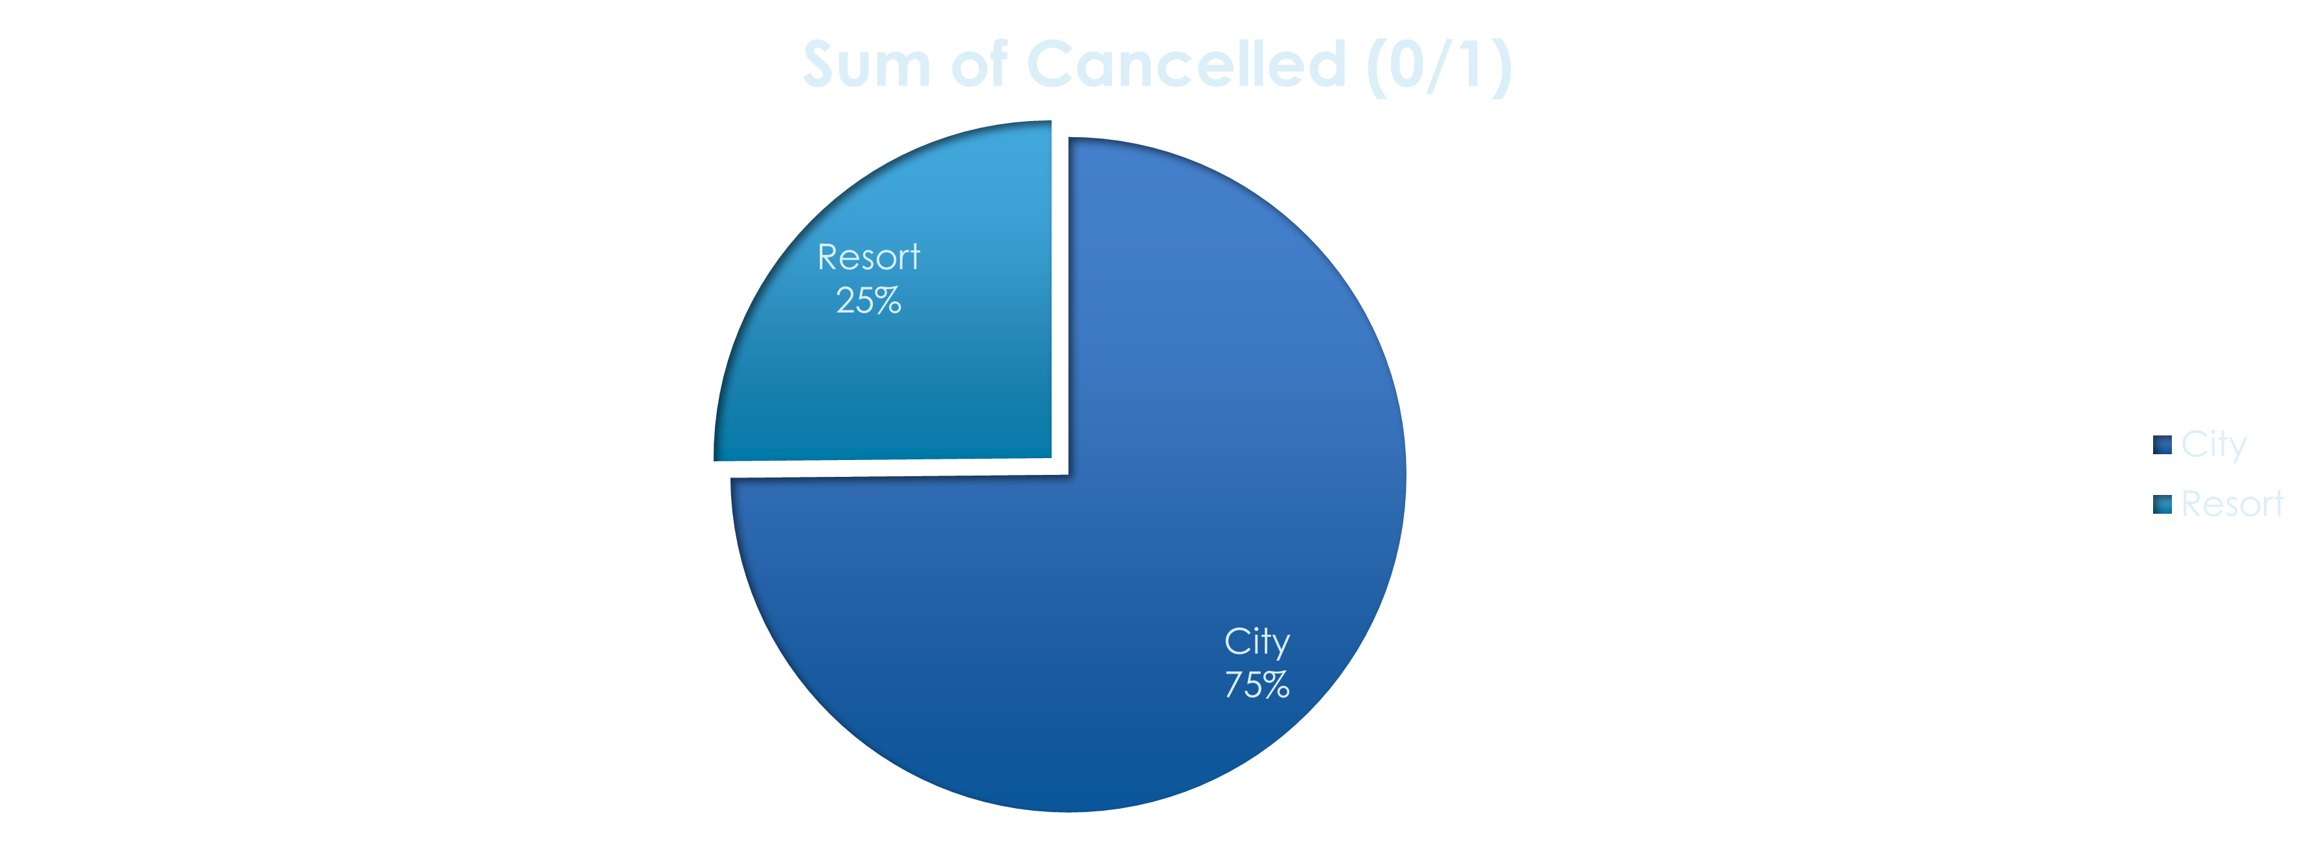
Cancellation by hotel type
Most cancellations (75%) occur in city hotels, suggesting greater booking flexibility or shorter stays

Slide 6
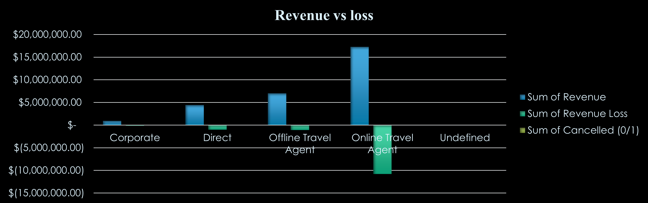
Channel-wise revenue vs loss analysis
Online Travel Agents generate the highest revenue but also account for the largest revenue loss due to cancellations

Slide 7
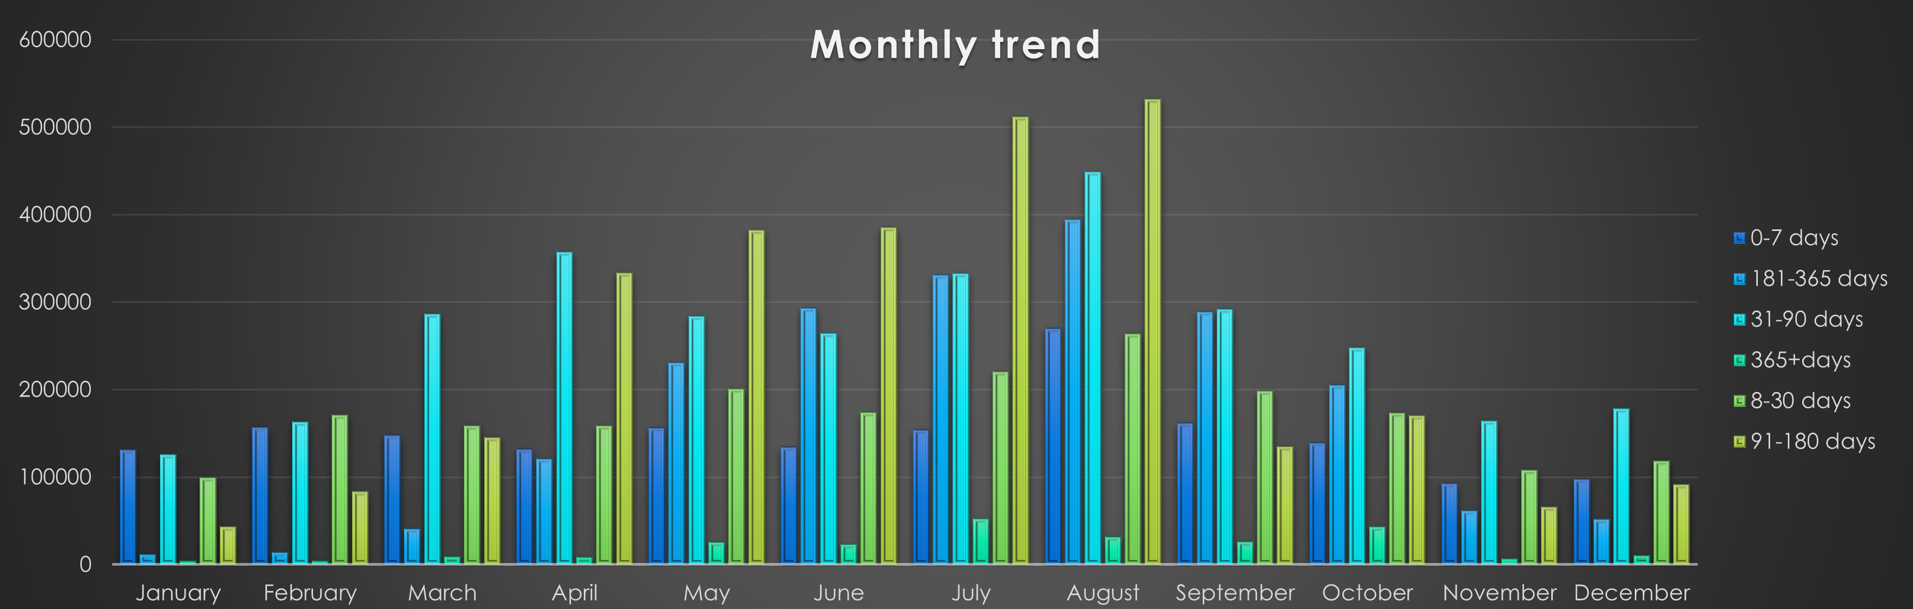
Monthly booking trends by lead time
Booking peak between April and august, especially during summer season with longer lead time(180+days), indicating strong
seasonal demand and opportunities for optimize pricing strategies.

Slide 8
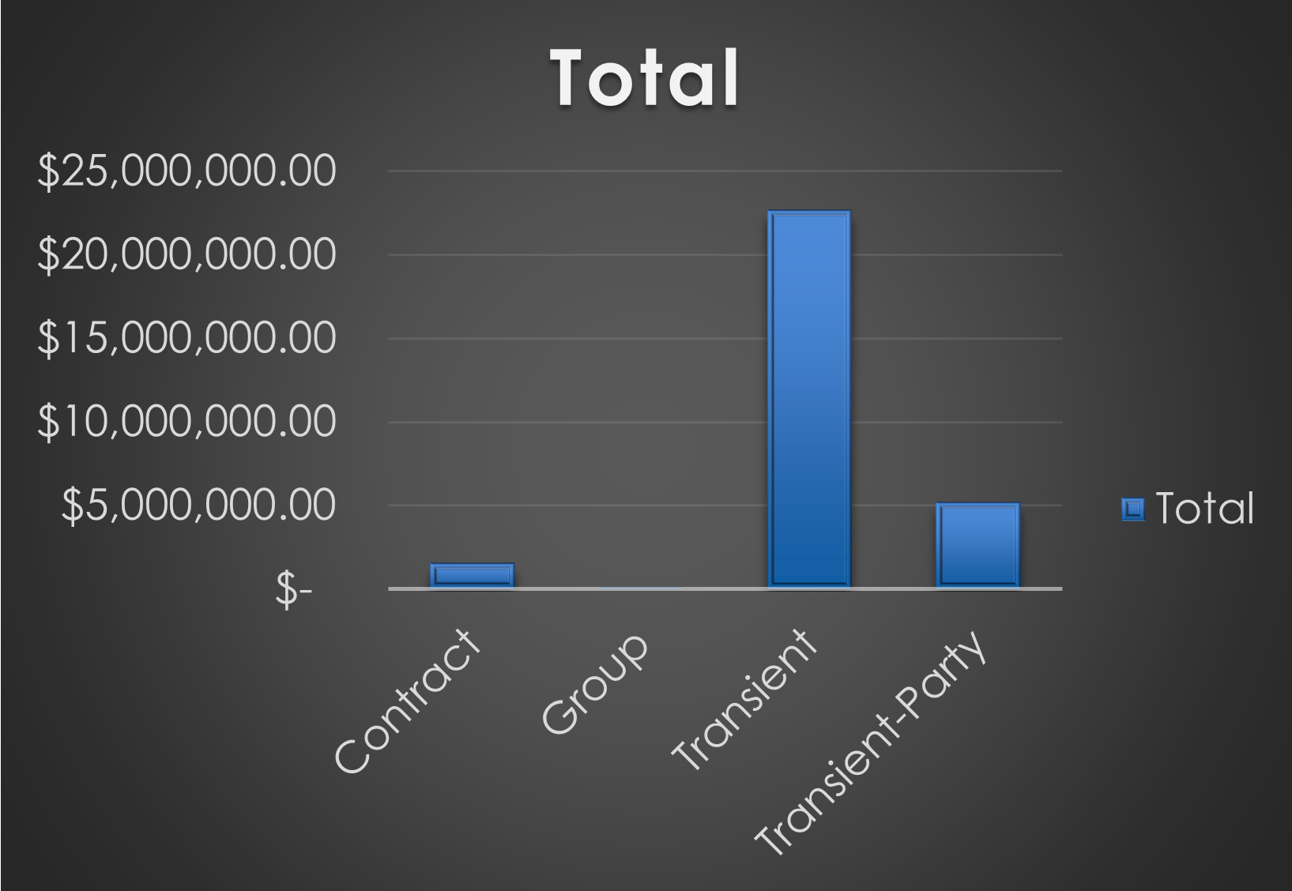
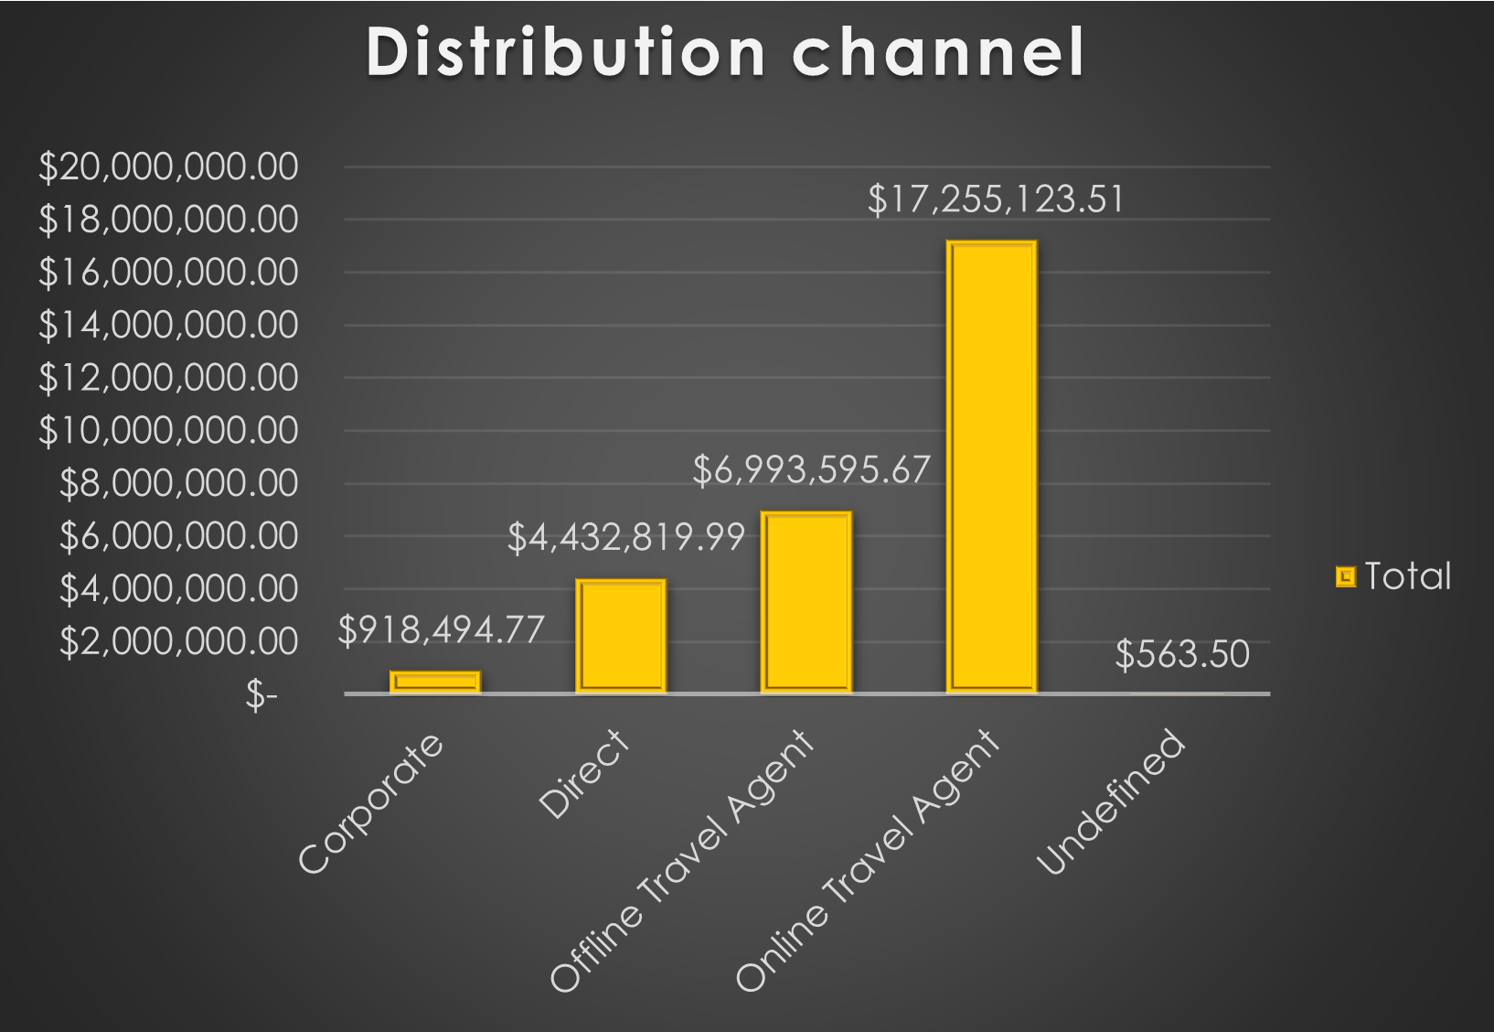
Revenue by customer type & channel
Most revenue is generated from Transient customer booking through Online Travel Agents

Slide 9
findings
City hotels experience significantly higher cancellation compared to resort hotels.
Most guests prefer city hotels, indicating stronger urban demand.
Portugal shows the highest number of cancellations, hinting at regional instability or travel flexibility.
Hotel revenue peaked in 2016, then declined in 2017.
Online travel Agent generate both the highest revenue and the most cancellations.
Booking between April to August, especially with long lead times(180+ days).
Transient customers and Online Travel Agent Channels Contribute the largest portion of revenue.

Slide 10
recommendation
Enforcing stricter cancellation policies or offering incentives for non-refundable booking.
Introduce loyalty programs to shift bookings to direct channels.
Launch targeted campaigns in high-cancellation regions to promote non-refundable deals and early bookings.
Invest in resort promotion through bundled vacation packages to increase occupancy and diversify booking distribution.
Introduce flexible stay options to attract diverse guests needs.
Strengthen communication with pre-arrival guests to reduce last-minute cancellations.
Get guests reviews and ratings to identify improvement areas and enhance retention.

Slide 11
CONCLUSION
This analysis reveals key factors driving booking cancellations, revenue patterns, pricing insights, and channel effectiveness. By implementing data-driven strategies, the hotel can significantly improve profitability and guests retention.

Slide 12
Thank you

